Slide 1


Sensors
Authors:
Yoav Rozov

Slide 2
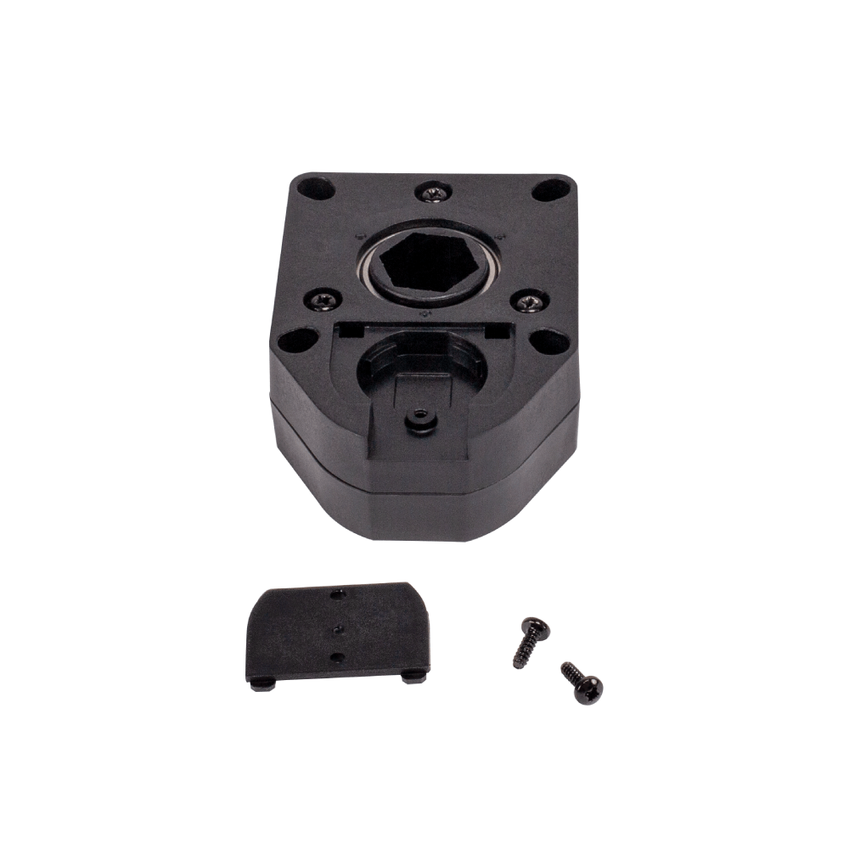
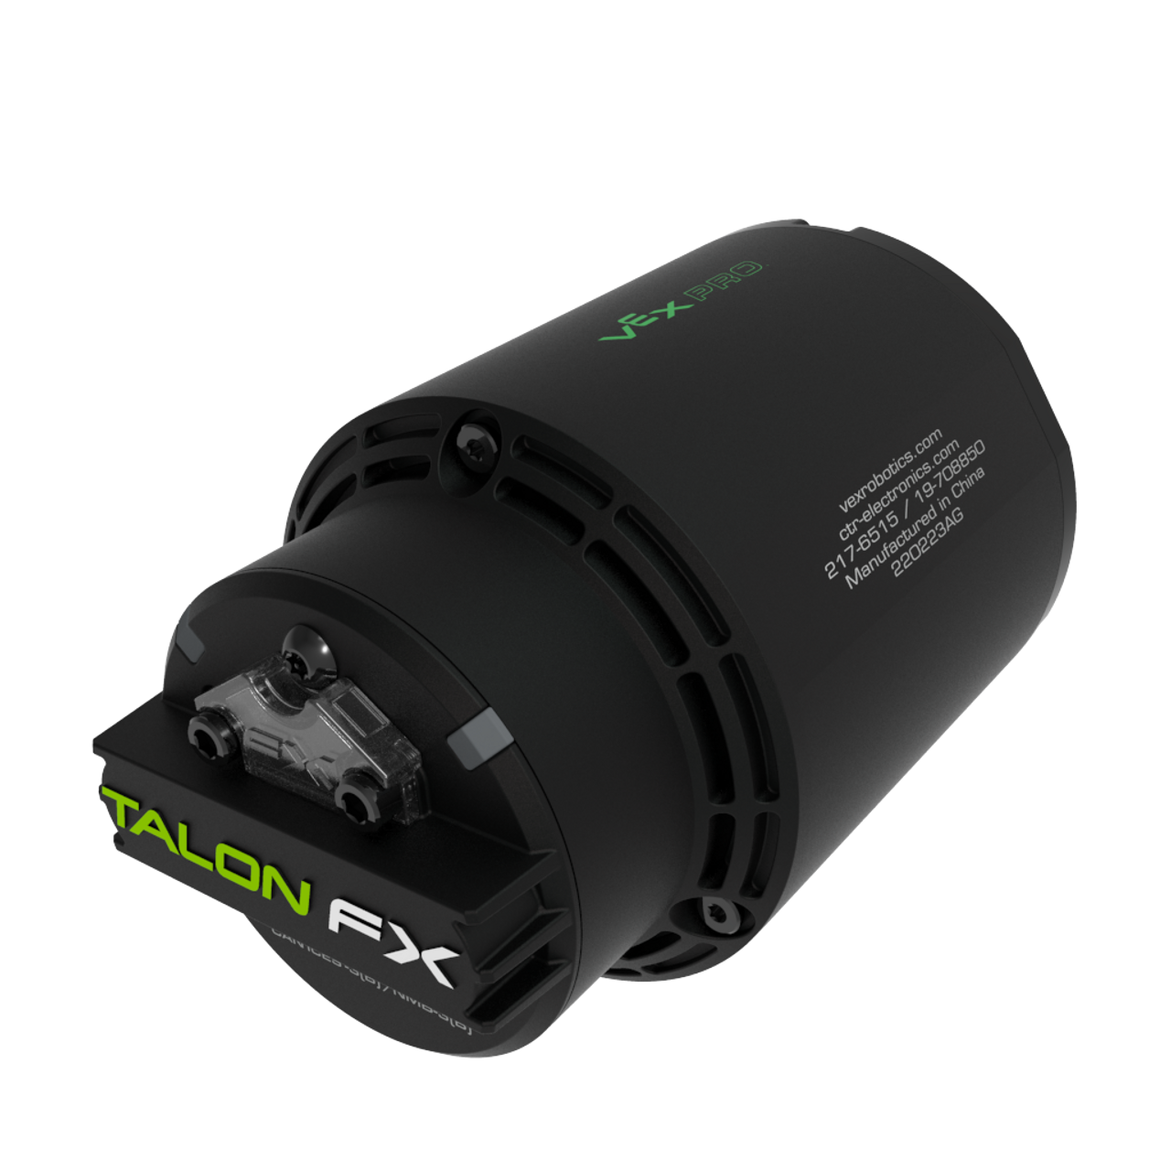
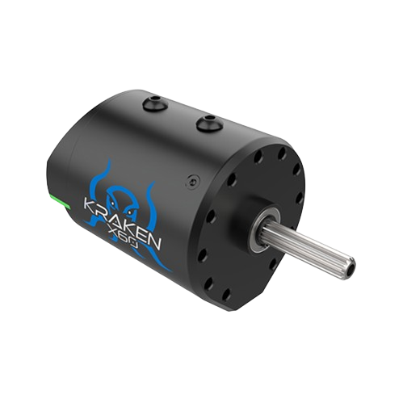
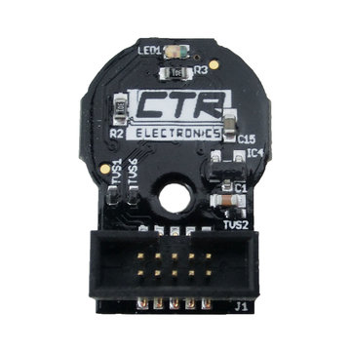
Encoder
Encoder
Sometimes present inside the motor itself
Encoders are connected directly to the motor controller
Usually installed inside encoder hubs

Slide 3
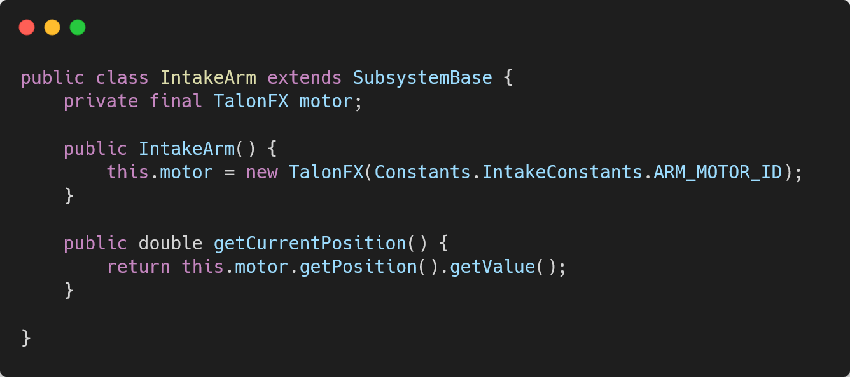
Encoder - Code
Used inside a subsystem class
Used through the talonFX class

Slide 4
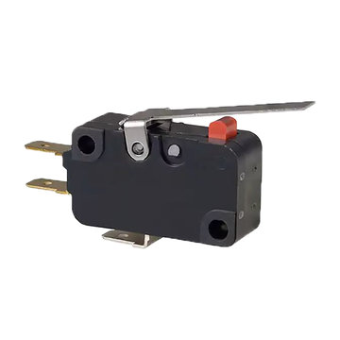
Limit switch
Switch
When the switch is pressed it either closes or opens an electrical circuit
We can detect that

Slide 5
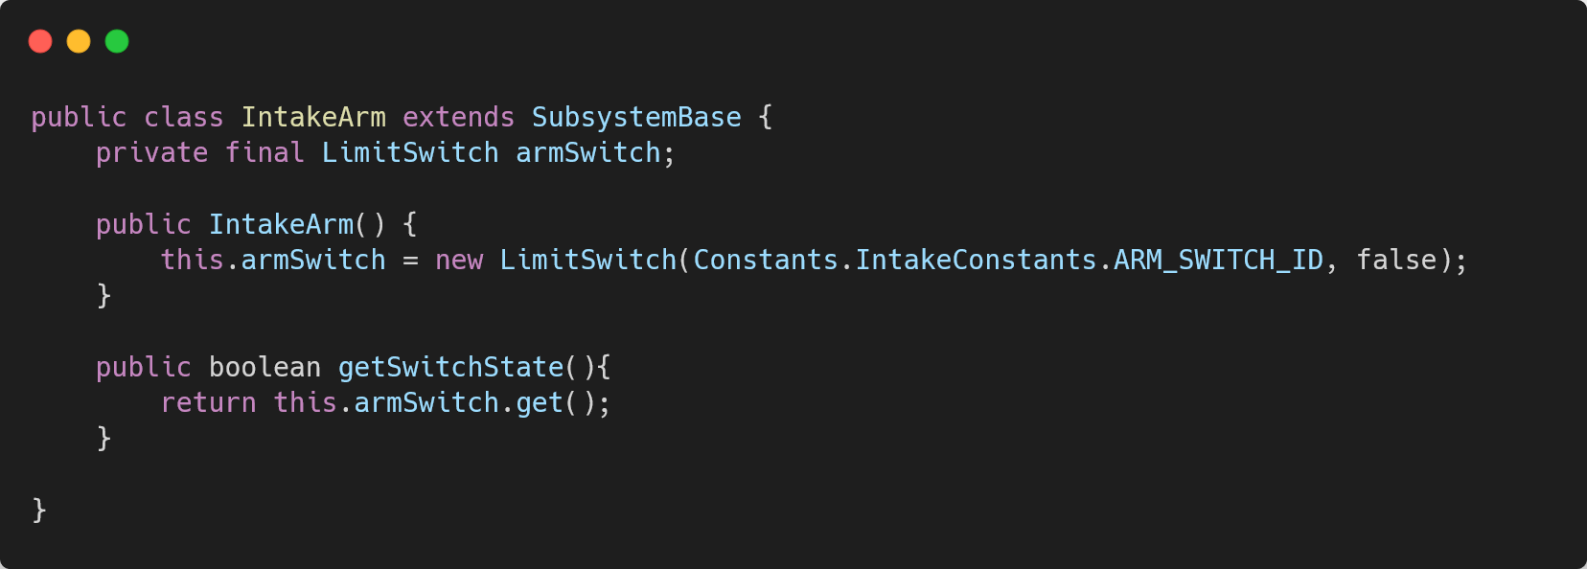
Limit switch - Code
Used inside a subsystem class
Is normally closed
*We will use a custom object “LimitSwitch” from “LimitSwitch.java” (source code here)

Slide 6
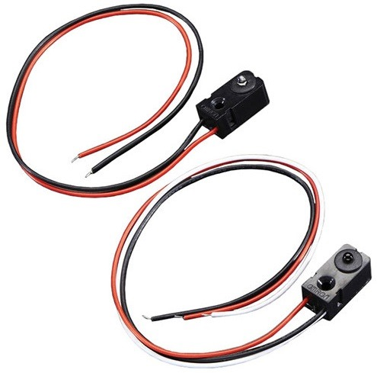
IR - Infrared sensor
IR
Has an emitter and a receiver
The emitter emits light which the receiver can detect
An object blocks the emitter, the light doesn’t get to the receiver
We can detect that

Slide 7
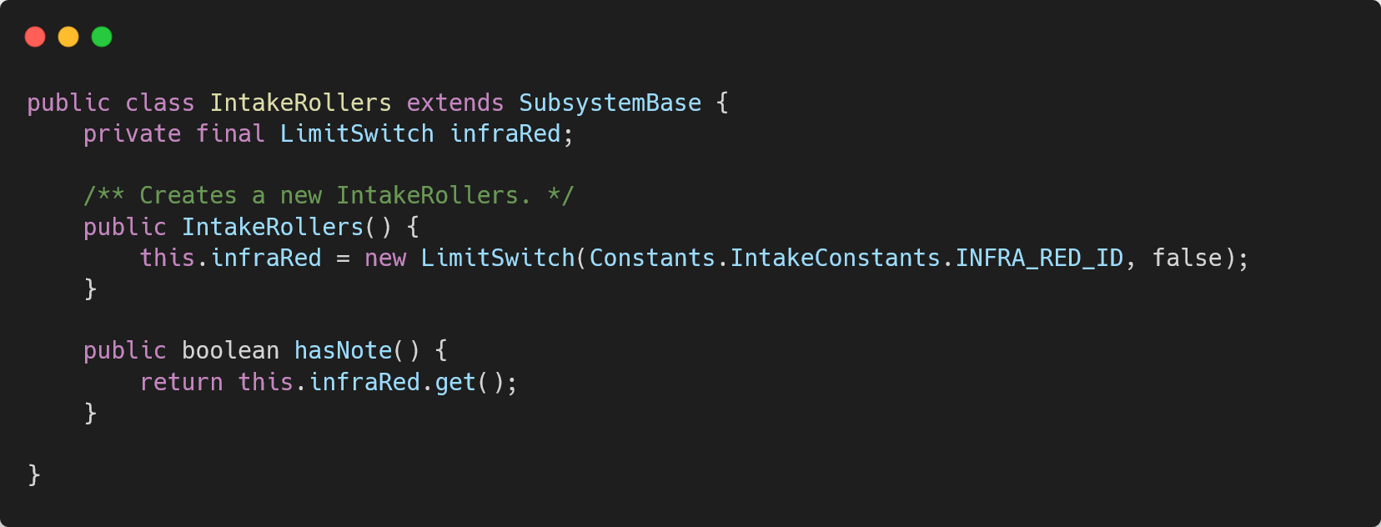
IR - Code
Used inside a subsystem class
Is normally closed

Slide 8

Practice

Slide 9
Intake note
Subsystems:
Create 2 subsystems for intake rollers and intake arm
Sensors:
Make sure to use encoders, limit switches and IR sensors.
Commands:
Create commands for closing intake and opening intake

Slide 10
תודה על ההקשבה

